Slide 1




NEXT GEN EMPLOYABILITY PROGRAM
Creating a future-ready workforce
Team Members
College Name
Student Name : Fathima Zehra P
Student ID : au311121104021
LICET

Slide 2

CAPSTONE PROJECT SHOWCASE
Project Title
MUSIC WEB APPLICATION USING DJANGO FRAMEWORK
Abstract | Problem Statement | Project Overview | Proposed Solution | Technology Used | Modelling & Results | Conclusion

Slide 3
Abstract
The core focus of this music web application is to provide users with a seamless listening experience coupled with interactive features. Through a secure login/signup system, users can access the vast library of music available within the service. Additionally, they have the unique capability to enjoy their favorite tunes while having the lyrics displayed in real-time, enhancing their engagement with the music.
Furthermore, users can curate personalized playlists, tailoring their listening sessions to their preferences and moods effortlessly. Moreover, they can connect with like-minded individuals by joining groups based on similar music tastes, fostering a sense of community and facilitating music discovery through shared interests. With intuitive features and a dynamic user interface, this application strives to elevate the music listening experience by empowering users to explore, connect, and enjoy their favorite tunes with ease.
Source :

Slide 4
Problem Statement
In today's digital landscape, the proliferation of music streaming platforms highlights a growing demand for a comprehensive music web application that prioritizes user engagement, customization, and ease of use. Despite the availability of numerous platforms, existing solutions often lack essential features such as real-time lyric display, personalized playlist management, and community-building functionalities based on shared music tastes.
The challenge is to develop a user-centric music web application that not only offers secure login and access to a diverse music library but also enhances the listening experience through synchronized lyric display. Additionally, the application should empower users to effortlessly create and manage custom playlists tailored to their preferences and facilitate connections with like-minded individuals through group memberships. The primary objective is to design an intuitive and user-friendly interface that enriches the music listening experience, fosters community engagement, and promotes music discovery seamlessly.
Source :

Slide 5
Project Overview
To develop a user-centric music web application using HTML, CSS, JavaScript, and Django. It will feature secure login/signup, real-time lyric display, personalized playlist management, and community-building features. The goal is to create a seamless and engaging platform for music enthusiasts to discover, listen, and connect with music effortlessly.
1. Secure Login and Signup: Users will be able to create accounts securely and log in to access the platform's features.
2. Music Playback with Real-Time Lyric Display: The application will allow users to listen to their favorite songs while displaying synchronized lyrics in real-time, enhancing their overall experience.
3. Personalized Playlist Management: Users can curate custom playlists tailored to their preferences, enabling them to organize and enjoy their music seamlessly.
4. Community Building: The platform will facilitate connections between users with similar music tastes through group memberships, fostering a sense of community and enabling music discovery.
5. User-Friendly Interface: The application will feature an intuitive and user-friendly interface, ensuring a smooth and enjoyable browsing experience for users of all skill levels.
Source :

Slide 6
Proposed Solution
Solution entails building an advanced music web application using HTML, CSS, JavaScript, and Django. This solution includes an intuitive interface with secure login/signup functionality. Additionally, we'll incorporate a sophisticated music player capable of seamlessly integrating lyrics with playback.
Moreover, it introduces a personalized playlist management features, allowing users to effortlessly curate and organize their favorite tracks. To enhance community engagement, group features facilitating connections among users with similar music tastes are implemented.
By prioritizing user experience and leveraging modern web development frameworks, solution aims to deliver a comprehensive music platform, exceeding conventional standards and providing users with an immersive and enjoyable music listening experience.
Source :

Slide 7


Technology Used
Front-end
Back-end
Source :

Slide 8
Modelling & Results
The architecture of the music web application is designed to ensure robustness, scalability, and security. Leveraging Django's MVC framework, the backend is structured to handle user authentication securely, manage extensive music libraries efficiently, and facilitate seamless playlist management.
On the frontend, focus was on creating an engaging and intuitive user interface. Modern web technologies such as HTML5, CSS3, and JavaScript libraries were utilized to craft a visually appealing and responsive design. The centerpiece of the frontend development was the integration of a dynamic music player component, seamlessly interfacing with external APIs to fetch and display lyrics subtly synchronized with the playback.
Source :

Slide 9
As for the results, secure user authentication mechanisms and ensuring the protection of user data were securely implemented. The music playback functionality delivers a smooth and uninterrupted listening experience, while the lyric display feature enhances user immersion without distracting from the music.
Moreover, user feedback on the interface's intuitiveness and the convenience of playlist management tools has been overwhelmingly positive. Users appreciate the seamless navigation and the ability to curate personalized playlists effortlessly.
Looking ahead, focus will be on further refining the application's performance, implementing additional features based on user feedback, and conducting extensive user testing to ensure optimal functionality and user satisfaction. Through iterative development and continuous improvement, a standout music web application that exceeds expectations and delights users
is to be delivered.
Source :

Slide 10
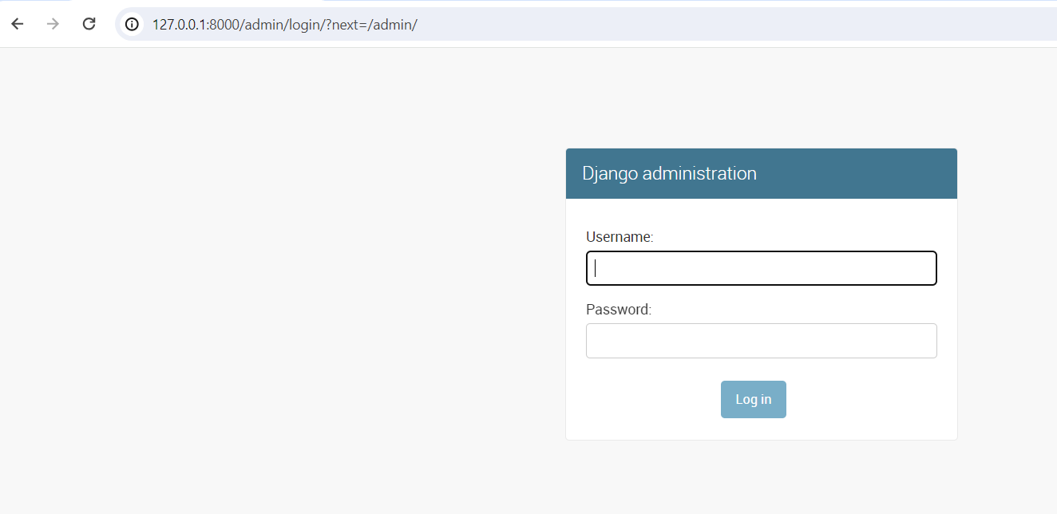
About-Us-Page

Slide 11
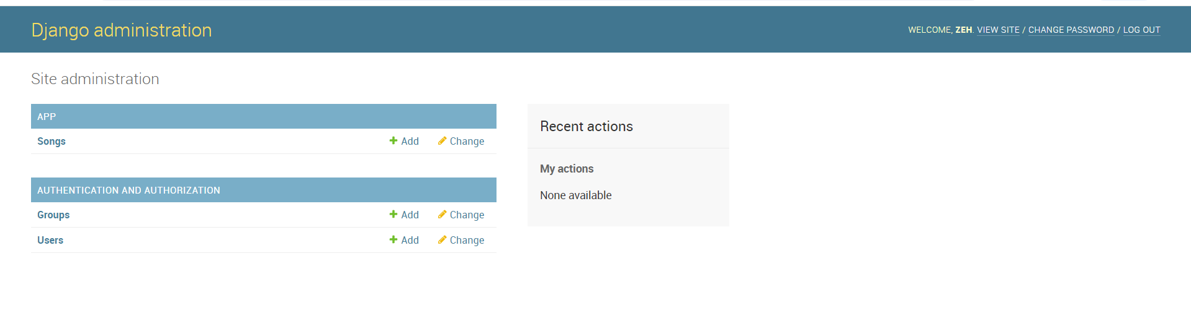

Slide 12
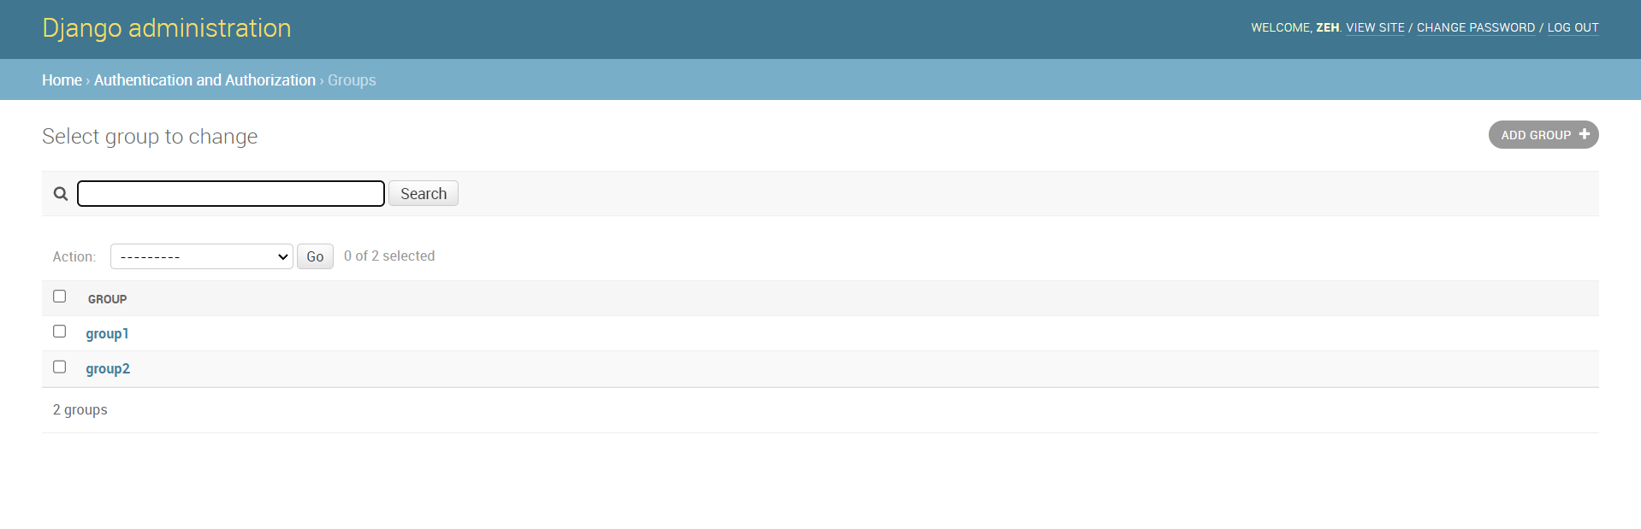

Slide 13
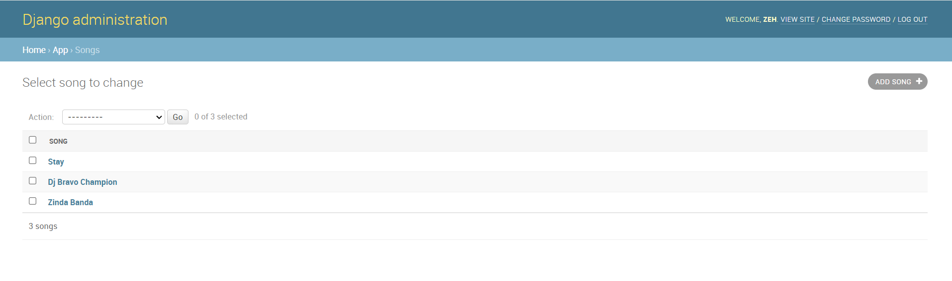

Slide 14
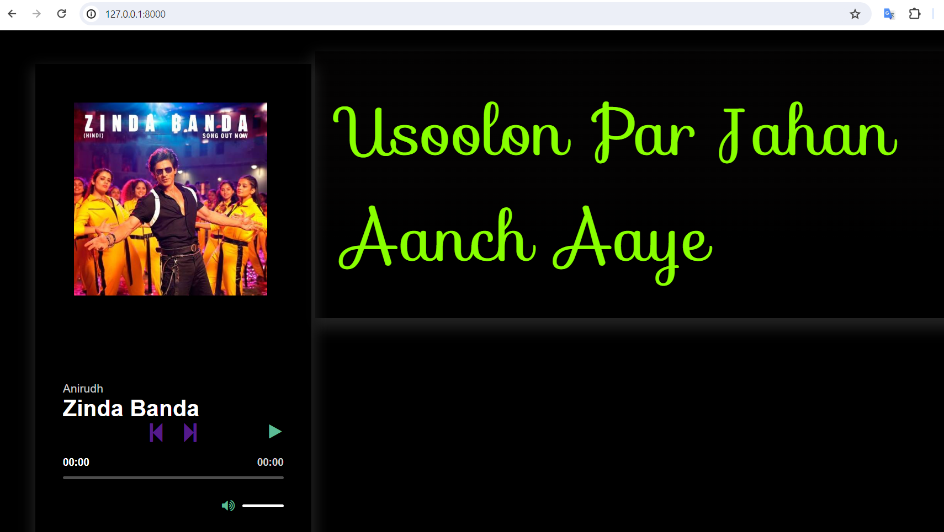
Service-Page

Slide 15
Future Enhancements:
-Personalized Experience: Our music web application offers a dynamic and personalized experience tailored to each user's mood and preferences.
-Mood-Based Playlist: Users can discover tunes matching their current state of mind, whether they're feeling upbeat, relaxed, or reflective, through our innovative mood-based playlist feature.
-Mood Prediction: Advanced algorithms anticipate users' moods and suggest songs that resonate with their emotional state, fostering a deeper connection with the music.
-Offline Listening: Users can download their favorite songs for offline listening, ensuring they can enjoy their music anytime, anywhere.
-Social Integration: Integrated social features enable users to interact with loved ones, sharing playlists, discussing favorite tracks, and connecting over mutual musical interests.

Slide 16
Conclusion
The music web application offers a seamless and immersive experience for users to explore and enjoy their favorite tunes. With secure login/signup, smooth music playback, and intuitive playlist management, a platform is created that prioritizes user satisfaction. Moving forward, committed to refining and enhancing the application based on user feedback, ensuring it continues to exceed expectations and provide a delightful music listening experience for all.
Source :

Slide 17
Thank You!
Notes:
Thank You !!

